Slide 1
10 steps to DevOps Part 3: Agile collabortion
James Tramel
Developer Strategist
james.tramel@microsoft.com
Notes:
a

Slide 2

Every app Every Developer Every Platform
Visual Studio Online
Visual Studio
.NET
Notes:
The tool for everything. .net, sharepoint – web forms.
Mobile development - pokemon
Web Developer – notepad – web extensions
Javascript – typescript angular.
Talking Points
With the increase and diversity of devices there is an opportunity for developers to reach users where they are.
Also with the power of the cloud, infrastructure and capital expenditures no longer have to be a barrier to creating great applications.
Visual Studio 2015 bridges mobile and the cloud by being the first version built to target mobile-first and cloud-first development.

Slide 3
Software delivery challenges
?
Frustration
Delays
Lack of insights

Slide 4
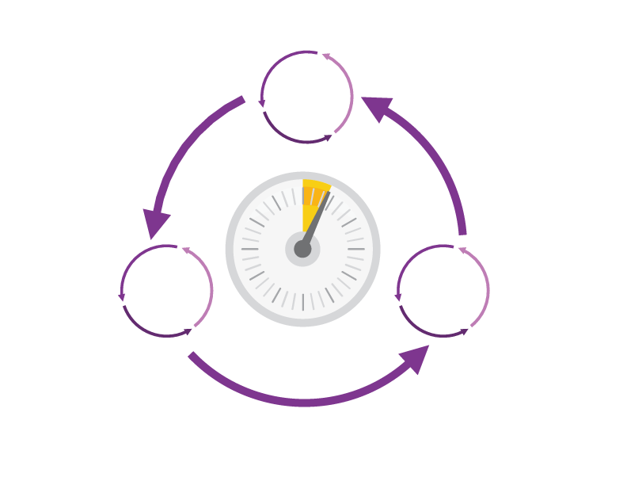
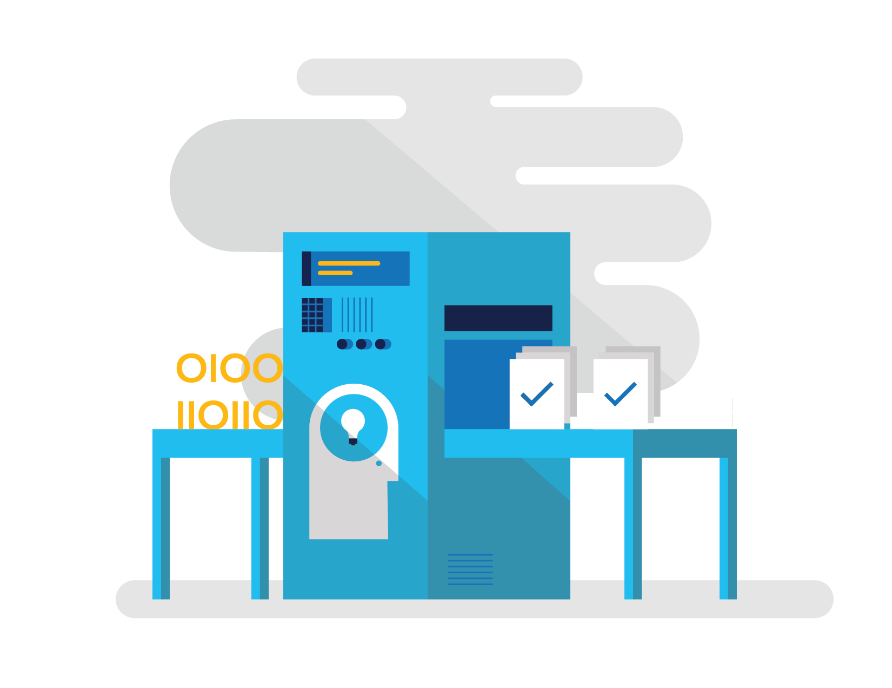
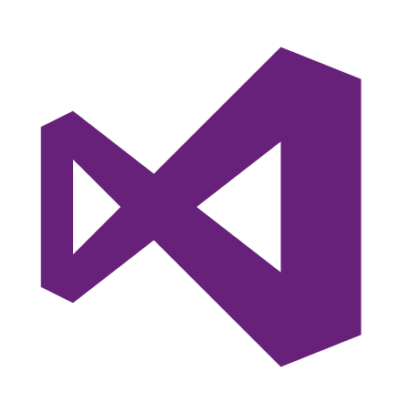
How Microsoft can help
Shorten Cycle Times
Optimize Resources
Improve Quality and Availablilty
Speed up and increase traceability of each release by empowering your development and operations teams with advanced collaboration and automation tools.
Efficiently manage environments using technologies that support self-service provisioning in a secure way, in line with your IT governance standards.
Capture rich telemetry on application performance and usage so that you can make better decisions on future investments and anticipate issues in production before they impact your service.
Visual Studio Team Services
Microsoft Azure
Visual Studio
Notes:
The Microsoft DevOps Solution provides a comprehensive set of software, cloud services, and other essential resources that help you deliver higher-quality software faster with less risk.
This solution is focused on addressing the most pressing challenges of the modern application lifecycle:
Shortening cycle times through advanced release management and automation tools
Optimizing resources and eliminating waste, and
Increasing quality and availability of your solutions

Slide 5






DevOps: the three components
DEV
OPS
1
People
2
Process
3
Products
Notes:
DevOps is the union of people, process, and products to enable continuous delivery of value to our end users.”\\
Focus today, from me, is process and products. Will focus on the how. The people is you. Be the change you want to see.

Slide 6
DevOps
1
4
Plan
Monitor + Learn
Development
Production
2
3
Develop + Test
Release

Slide 7

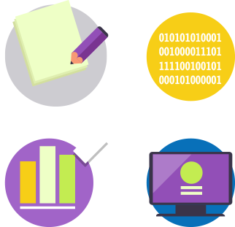


Visual Studio Enterprise – the tool for DevOps
Optimized for enterprise-class development
An integrated, end-to-end solution for teams of any size with demanding quality and scale needs. Take advantage of comprehensive tools and services for designing, building and managing complex enterprise solutions.
Greater productivity for enterprise application development and delivery
Plan, execute and monitor your entire quality effort, continuously
Manage complexity and close
the loop between Dev and Ops
Notes:
The tool for everything. .net, sharepoint – web forms.
Web Developer – notepad – web extensions
Javascript – typescript angular.

Slide 8
DevOps habits and practices
BACKLOG refined with LEARNING
MANAGED TECHNICAL DEBT
PRODUCTION FIRST MINDSET
INFRA-STRUCTURE is a FLEXIBLE RESOURCE
TEAM AUTONOMY & ENTERPRISE ALIGNMENT
EVIDENCE gathered in PRODUCTION
FLOW OF CUSTOMER VALUE

Slide 9
DevOps habits and practices
LEARN
Application Performance Management
Infrastructure as Code
Continuous Deployment
Release Management
Configuration Management
Automated Recovery
PLAN
Source Control
Stakeholder Feedback
Kanban
Bug Tracking
TEST
Application Performance Management
Usage Monitoring
Telemetry Collection Testing in Production
Stakeholder Feedback
APPROVE
Feature flags
Code Reviews
Automated Testing
Continuous Measurement
BACKLOG refined with LEARNING
MANAGED TECHNICAL DEBT
PRODUCTION FIRST MINDSET
INFRA-STRUCTURE is a FLEXIBLE RESOURCE
TEAM AUTONOMY & ENTERPRISE ALIGNMENT
EVIDENCE gathered in PRODUCTION
FLOW OF CUSTOMER VALUE
APP
Automated Testing
Code Review
Technical Debt
Continuous Integration
Continuous Deployment
Release Management
iNFRA
Automated Enviornment De Provision
Self Service Enviornment
Auotmated Recovery
MONITOR
Infrastructure as Code
Continuous Delivery
Release Management
Configuration Management
Automated Recovery
Testing in Production
Usage Monitoring
User Telemetry
Notes:
Automated Testing
Continuous Integration
Continuous Deployment
Release Management
Usage Monitoring
Telemetry Collection
Testing in Production
Application Performance Management
Infrastructure as Code
Continuous Delivery
Release Management
Change / Configuration Management
Automated Recovery
Load Testing
Avaialability Monitoring
Capactiy Management
Automated Enviornment De Provision
Self Service Enviornment
Auotmated Recovery (roll back / roll forward)
Stakeholder Feedback
Feature flags
Code Reviews / Technical Debt

Slide 10
Dev Ops Skill Katas
Modern Debugging
Automated Unit Testing and Architectural mapping
Work item / bug tracking
Integrated testing / technical debt management
Continuous configuration / package management
Continuous deployment / integration
Release management
Dev / test environments
Infrastructure as code
Monitor and analyze
Notes:
Social club – intellitrace – works on anything .net
Taxation – intellitest and code maps
Sonar qube – vstsdemo – my shuttle 2 – myshuttle ci
https://sonarqube.com/, click rules
Package manager – parts unlimited – build – surreal engine – show feeds
Continuous integration – click on triggersin a build
Continuous deployment – parts unlimited
http://partsunlimited.azurewebsites.net/
Show deployment slots
Azurejut – dupont welcome -
Release – show Aramark azurejt
IAC – show github repo
Show create a new resource
https://github.com/Azure/azure-quickstart-templates
Dev test labs – en portal
Monitor and analytiz – so java portal or farkacam on my portal

Slide 11
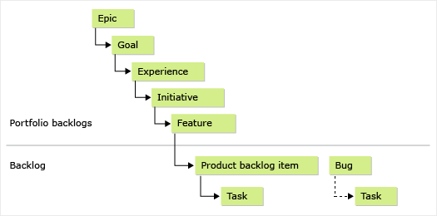
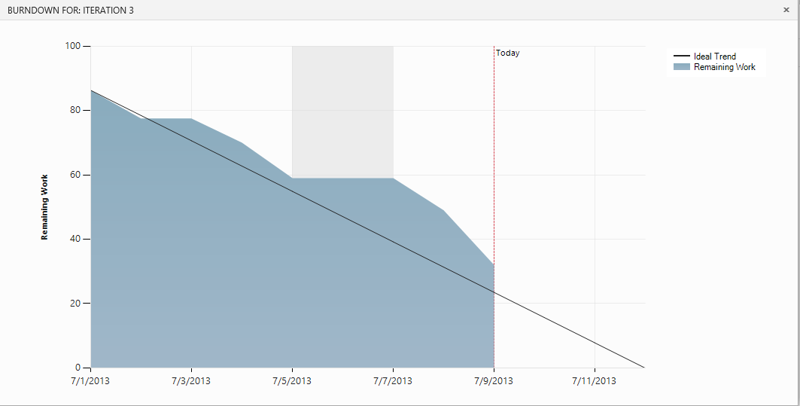
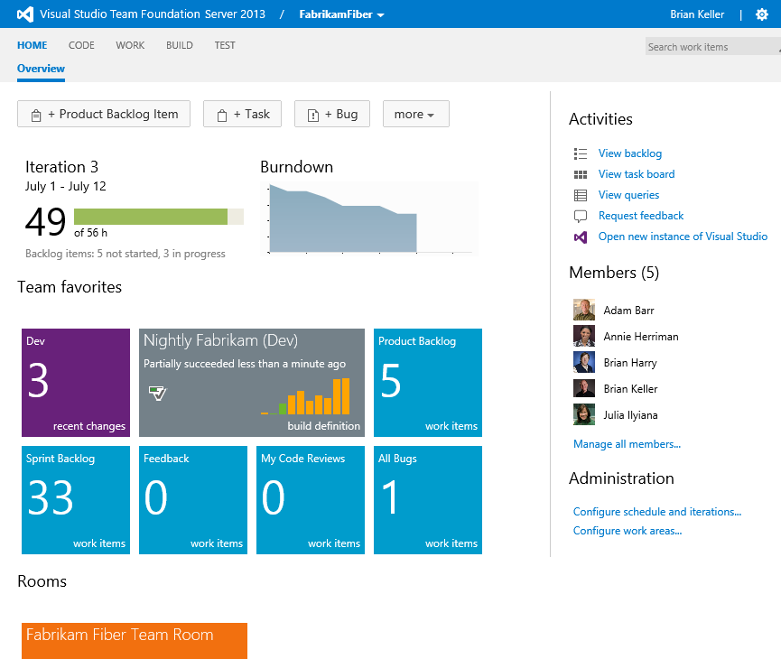
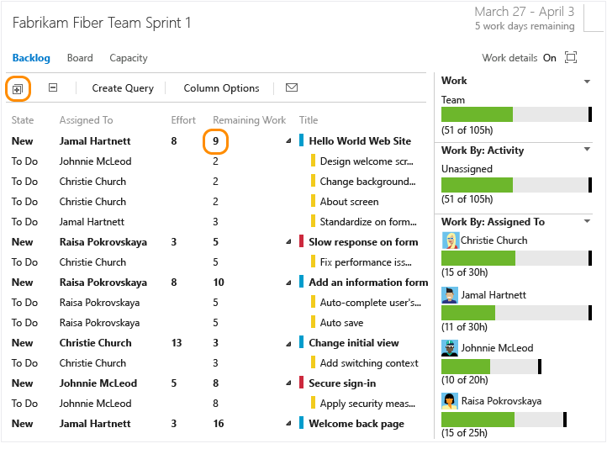
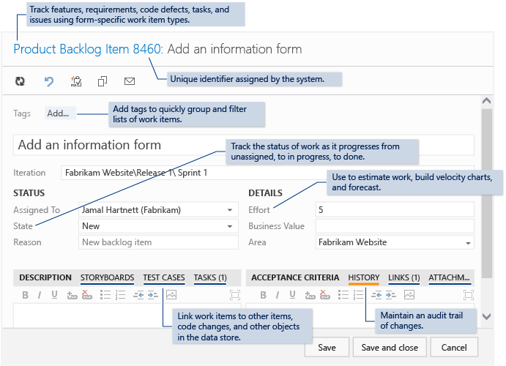
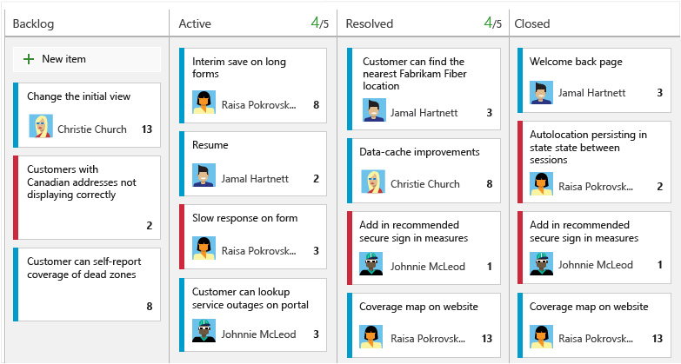
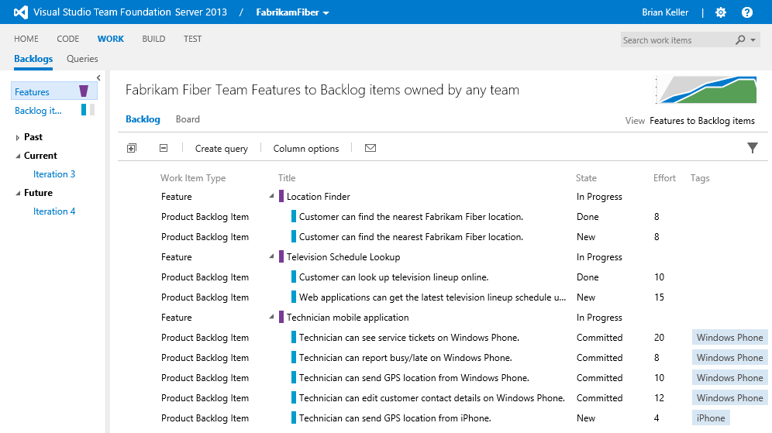
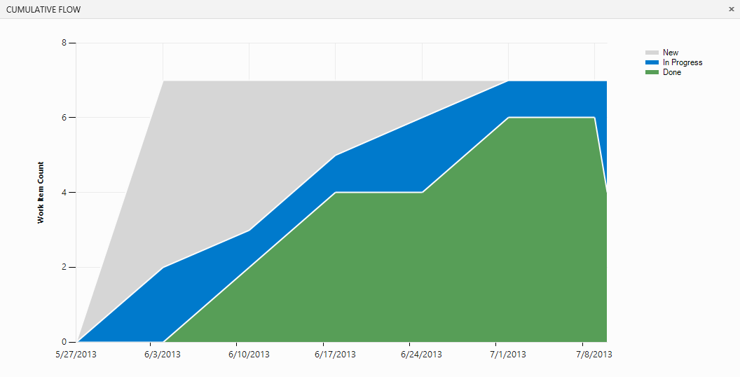
Enterprise Agile
Portfolio Management
Kanban Boards
Visualization
Sprint Management
Work Item
Notes:
Adopt agile techniques to become more effective.
Agile planning tools (like capacity planning, task boards, Kanban boards, and backlog management) offer your teams the flexibility to adopt incremental development techniques and agile methodologies (like Scrum) at their own pace. Use the same tools to enhance your current methodology more gradually.

Slide 12
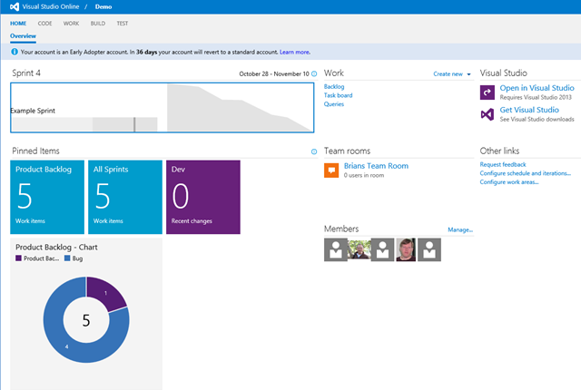
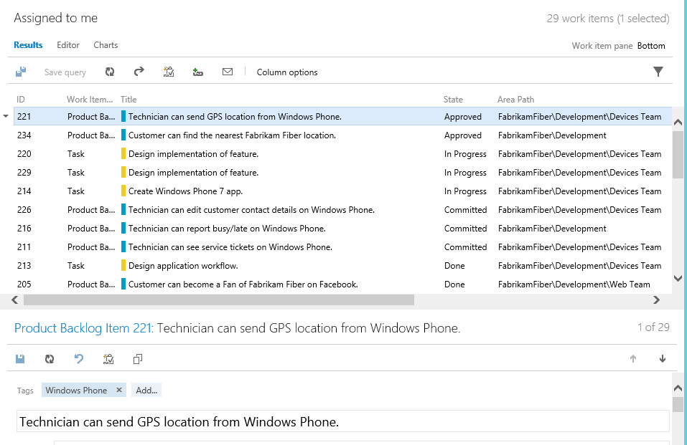
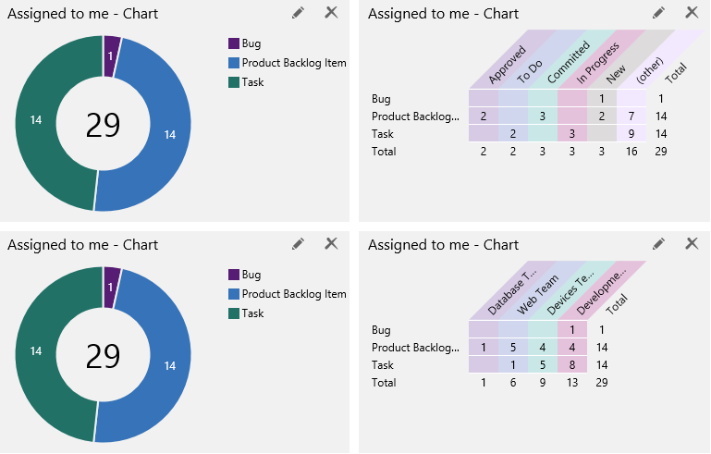
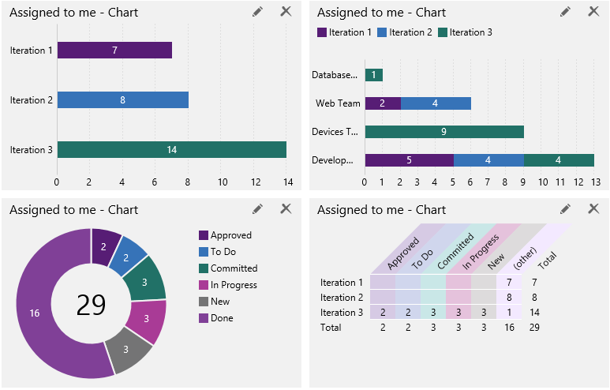
Work Item Charting
Turn a Query
Into a Chart
Slice and Dice
Add to Dashboard
Notes:
Visualize full requirements traceability.
Gain full traceability and visibility into the progress and quality of each requirement, tracking back work items and test cases to business goals.
Work Item Charting allows you to use a browser based interface to create visual chart representations of the data returned from a TFS query. This allows us to build up a view of visual representations of work item data that help us understand the state of our projects better in a simple to use way.

Slide 13
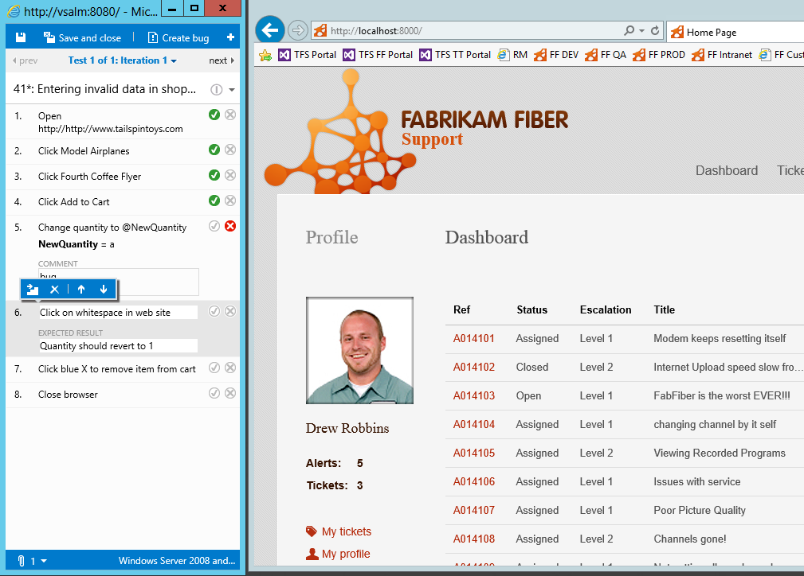
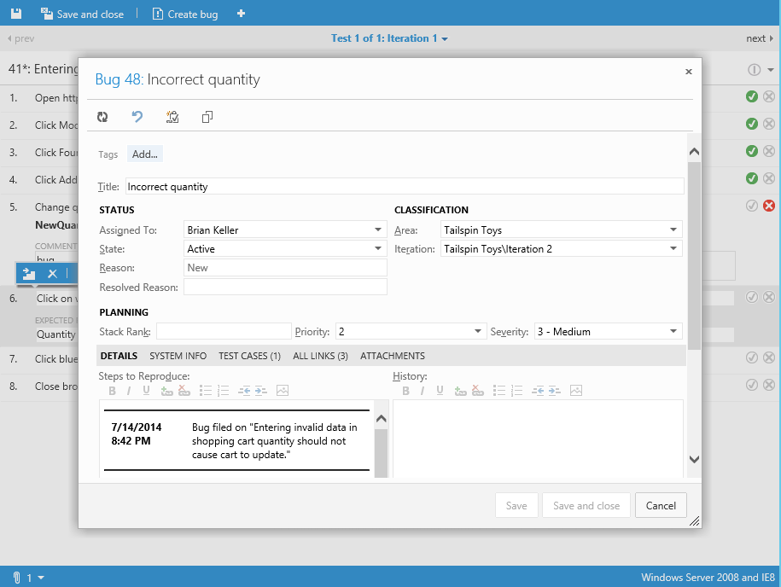
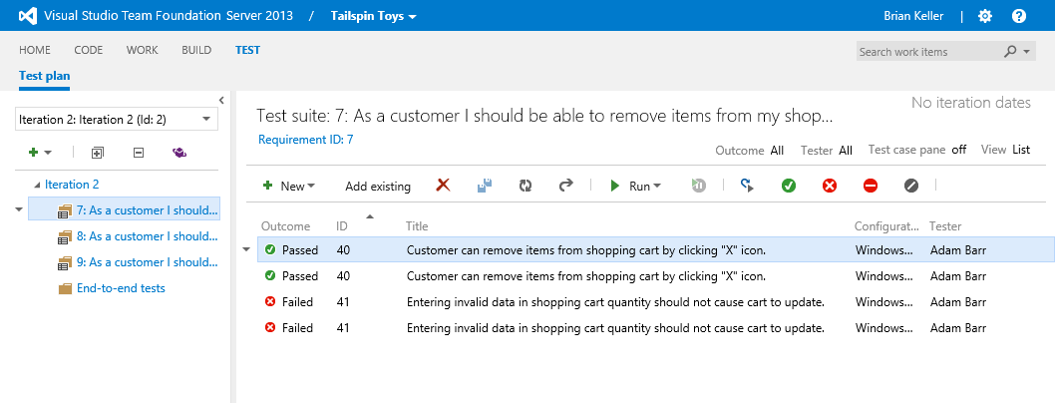
Manual Testing
Web Access
Manage Test Plans
Run Test Cases
Create Bugs
Notes:
Test functionality is now included in Team Web Access
Lightweight browser-based test management makes manual testing easy:
Create test plans.
Manage your test suites.
Create test cases including shared steps and parameters support.
Bulk entry and bulk edit of test cases with a grid view.
Copy test cases from Excel to a grid view. Also, copy test cases from a grid view to Excel.
Run tests.
Edit test cases while running the tests.
Test Windows Store apps running on a remote device using manual tests.
To get started, see Plan Manual Tests using Team Web Access.
http://msdn.microsoft.com/en-us/library/dn268304.aspx

